Slide 1
Introduction to L-systems
Understanding Procedural Generation

Slide 2


What are L-systems?
L-systems (Lindenmayer systems) are formal grammars primarily used to model the growth processes of plants and fractals. They consist of an alphabet of symbols, an axiom (initial string), and production rules that define how each symbol can be replaced.

Slide 3
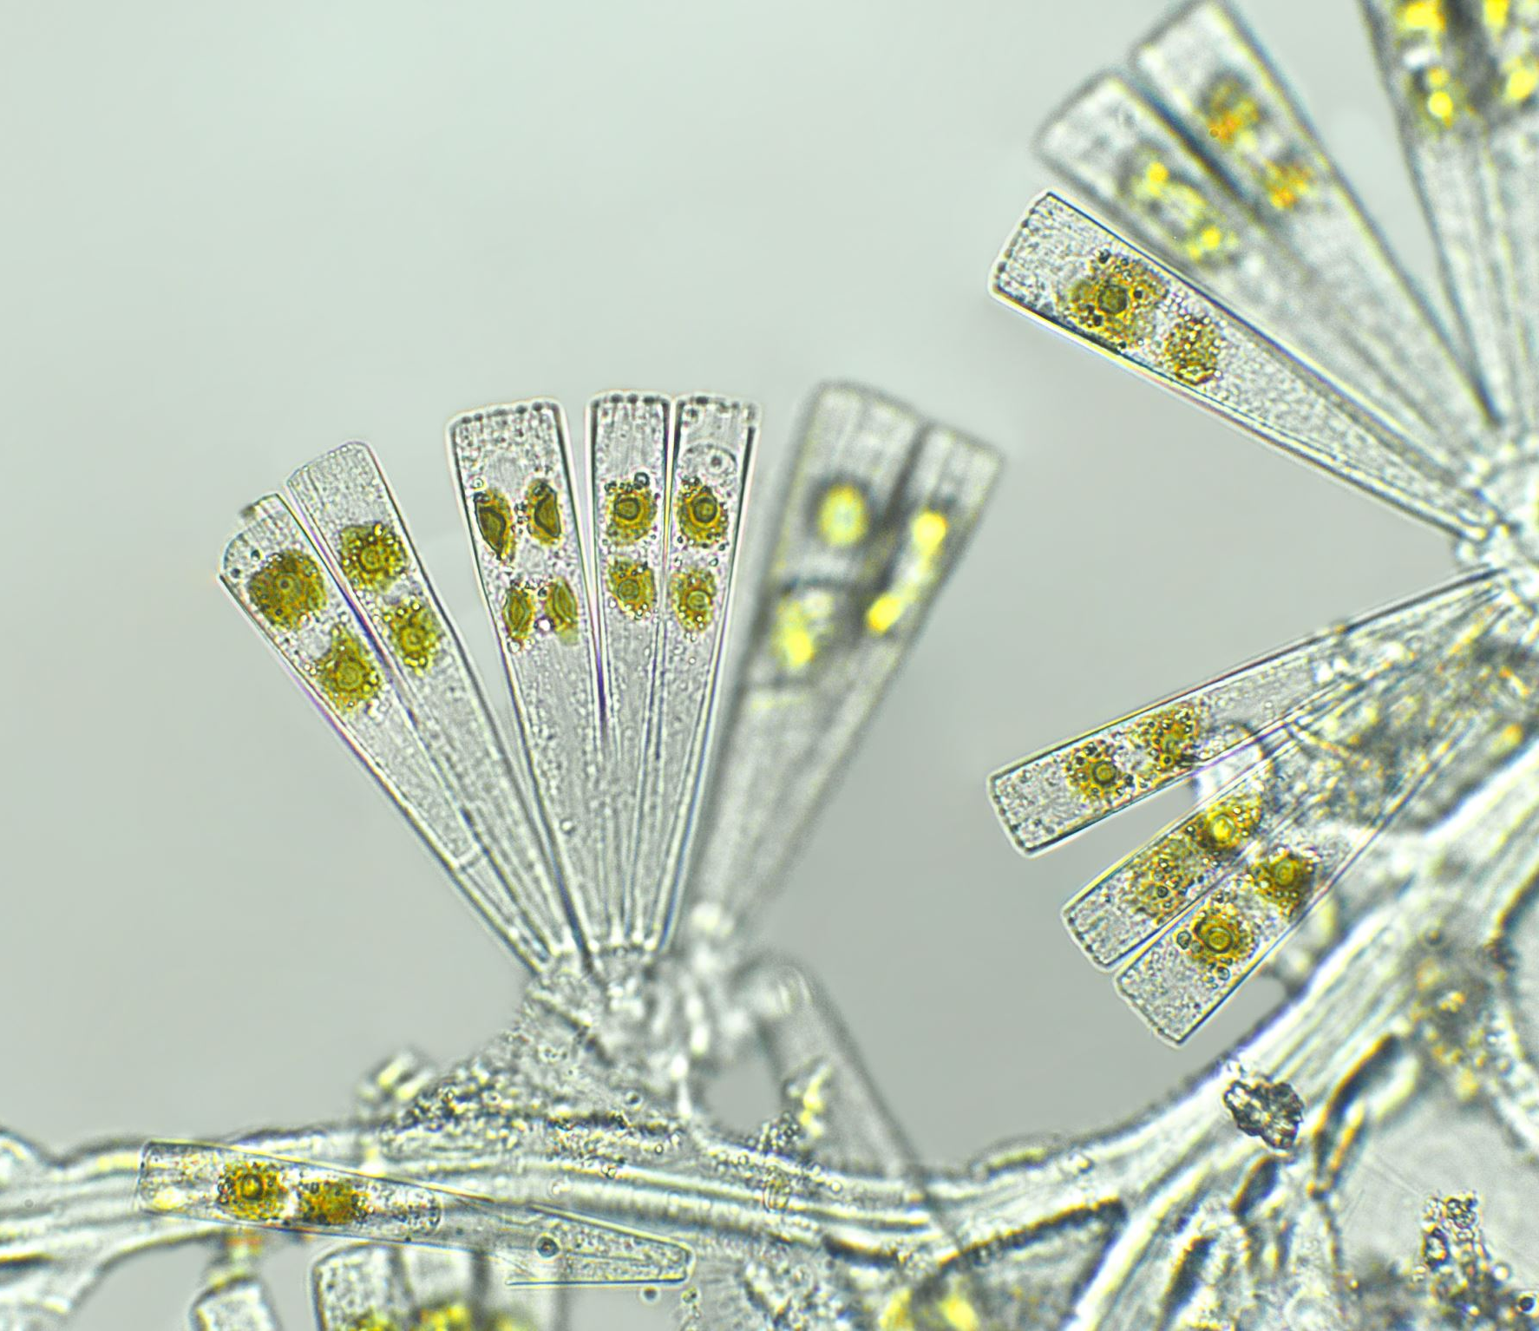
History of L-systems
L-systems were introduced by the biologist Aristid Lindenmayer in 1968. They were initially used to model the growth patterns of algae, but have since been applied to various biological and computer graphics applications.
L-systems are a mathematical formalism that can be used to model the growth processes of plant development.

Slide 4
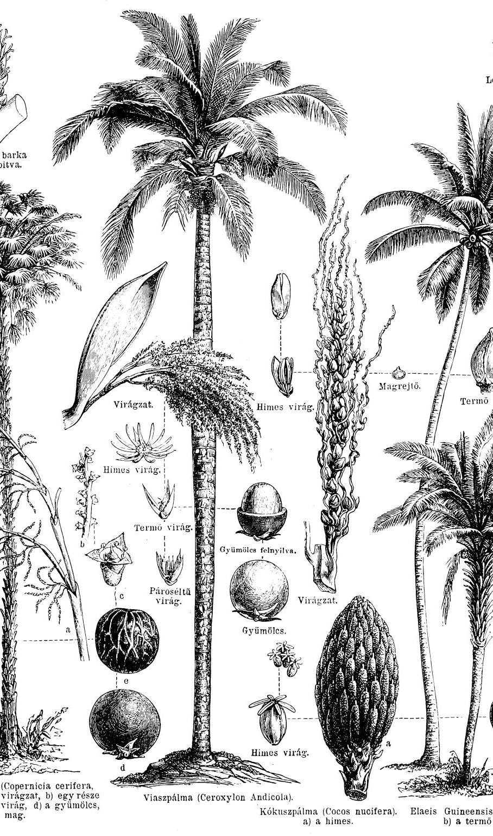
Applications in Computer Graphics
Modeling realistic plants and trees in movies and games.
Creating fractal landscapes and terrains.
Simulating natural growth processes.
Generating textures and patterns.

Slide 5

Example: Plant Generation
Using L-Systems, we can generate complex plant or Tree structures by defining simple rules. For example, a rule set can define how branches and leaves grow recursively.

Slide 6
Basic Concepts
Alphabet: A set of symbols used in the L-system.
Axiom: The initial string from which generation begins.
Rules: Production rules defining how each symbol can be replaced.
L-Systems use a set of rules and symbols to recursively generate complex structures. They consist of an axiom (initial string) and production rules that replace each symbol with a string of symbols.

Slide 7
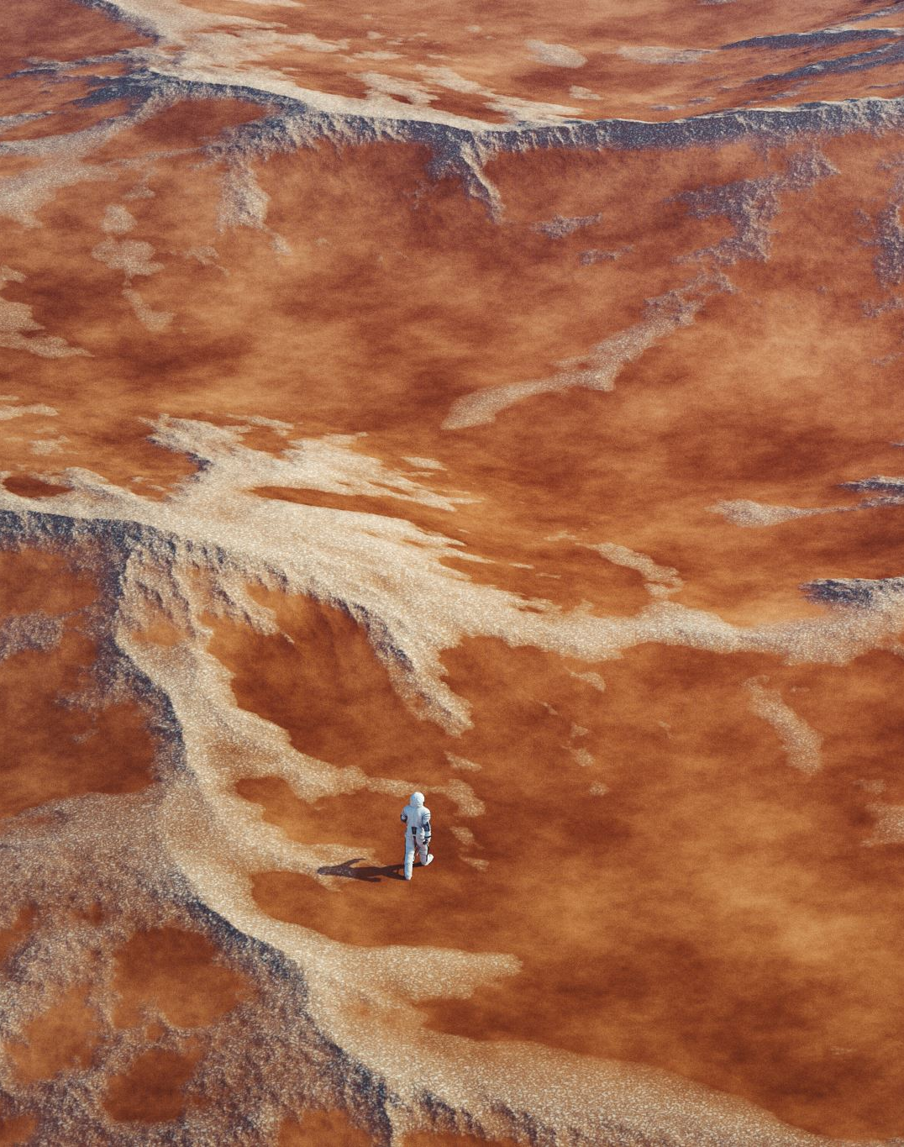
Example: Terrain Generation
L-Systems can be used to create realistic terrain by defining rules that simulate natural erosion and deposition processes. This can be used in games to add a more dynamic feel to landscapes.

Slide 8

Example: Fractal Trees
Fractal trees can be generated using L-Systems by defining rules that create branching patterns. Each iteration adds more branches, creating a realistic tree structure.

Slide 9
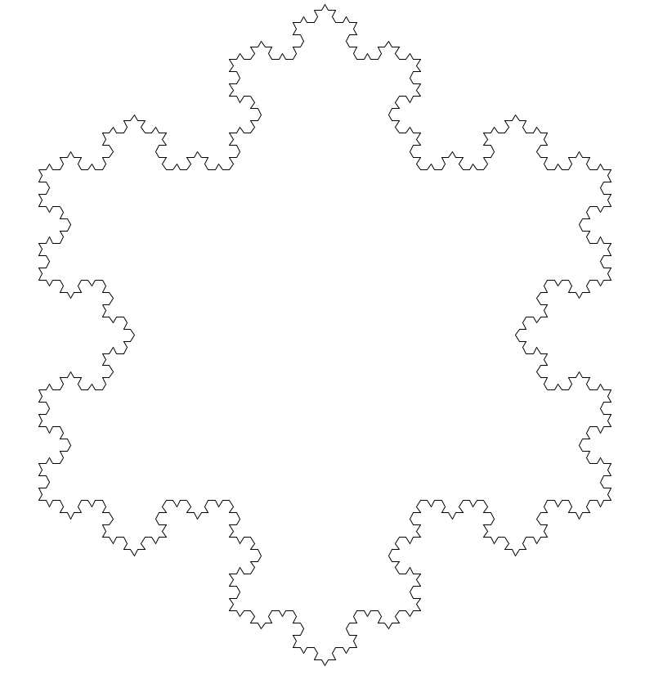
Heres the Simplest L-system I can think of
Alphabet: {F}
Axiom: F++F++F
Rule: F -> F=F-F++F-F
Turn Angle: 60
This example generates the Koch Curve.

Slide 10
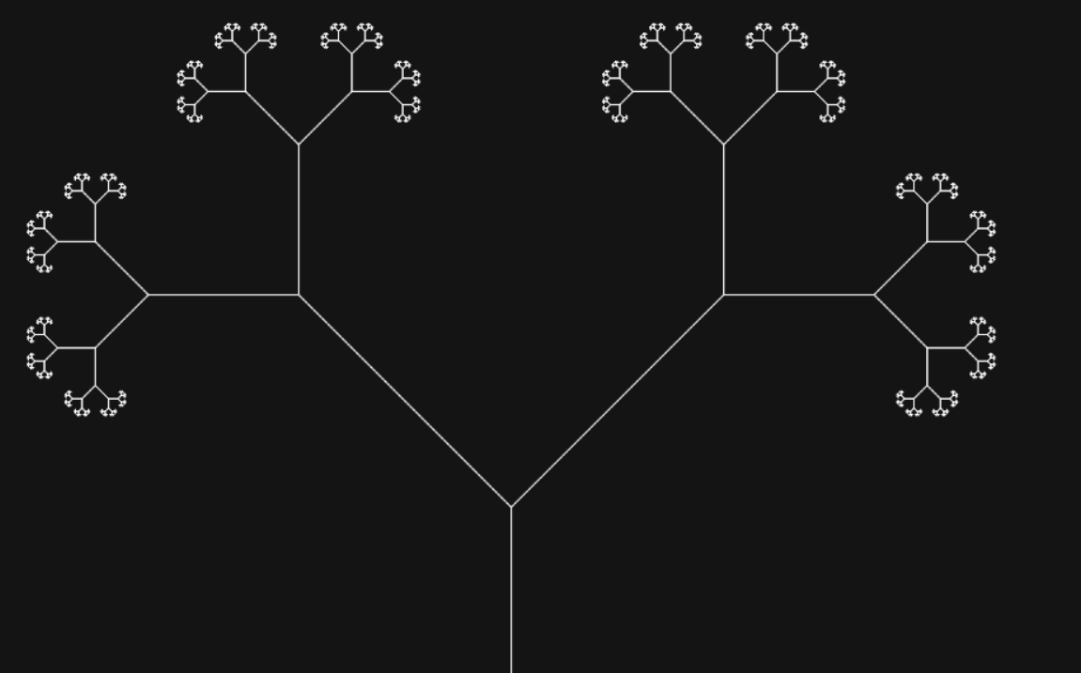



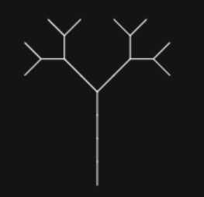
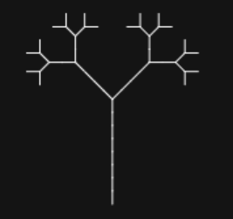
L-system, Theory
We start a simple X or F.
We store these in a stringbuffer and go through each character
If character is a X we replace it with F[X]X
Else it will be a F which gets replaced with FF
Depending how many times we do this depends on how big the string and tree will be, but for simplicity let’s do it 2 times.
Iterations: | X
1 | F[X]X
2 | FF[F[X]X]F[X]X
Rules:
X=F[-X][+X]
F=FF
Why not test your Math on https://piratefsh.github.io/p5js-art/public/lsystems/
. . . . . . . . . . 10 =>
Notes:
A=60 / ax=F++FF++FF++F / r=F=F+F i=3

Slide 11
L-Systems – An Algorithmic Visualisation
Take a custom alphabet [VARIABLES]
A B
A → AB
Take a custom ruleset [RULES]
A and B are replaceable by rules
B → A
A
Take a starting string [AXIOM]
Sometimes you will have symbols that cannot be replaced by rules [CONSTANTS]
Algorithm Data
n (iterations) = 4
Iteration 1 = A
A
Iteration 2 = AB
axiom = A
Iteration 3 = ABA
rules = (A → AB), (B → A)
A
B
Iteration 4 = ABAAB
A B
A
Final string (iteration 4) = ABAAB
A B
A
Final string (with 6 iterations) = ABAABABAABAAB
A B

Slide 12
L-Systems – An Algorithmic Visualisation
L-Systems use the current string to construct a more complex string.
This is why they are said to be recursive in nature.
Final string (iteration 4) = ABAAB
Each character (A and B) within the string corresponds to a rule.
A = Move forward.
B = Rotate 45 degrees clockwise.
When each character is evaluated, an action is applied to a ‘turtle’.
The turtle will draw a line behind it, after each movement.
(iteration 1) = A
(iteration 2) = AB
(iteration 3) = ABA
(iteration 4) = ABAAB

Slide 13
Now read the string into graphics
We can now read that long string to graphics using our favorite graphics / game engine
FF[F[X]X]F[X]X
Again go through each character and if that character is:
X - Draw a line that will end in a leaf
F - Draw a Line
[ - push onto a stack the position and angle the rotate 45 Degrees left.
] - pop from the stack restoring the position and angle and rotate 45 Degrees right.
L-Systems can also be used to generate building blocks and city layouts.

Slide 14
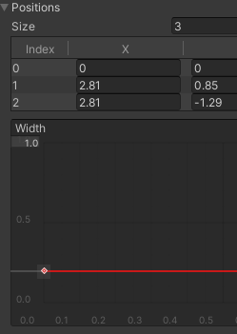
Implementing L-systems in Unity
You may be unfamiliar with Line Renderer
Let’s create a new Unity Scene to implement L-systems.
Add a new empty GameObject
Add a Line Renderer Component to this GameObject
The default thickness is too thick, Set width to 0.1
Add a material or it will likely be pink
Experiment by adding a few points to get the gist of how it works and to set up the camera better in the scene.
Helper task sheet: Week 05 - Lindenmayer Systems - Task 01.pdf
Notes:
Demonstrate how line renderer works

Slide 15
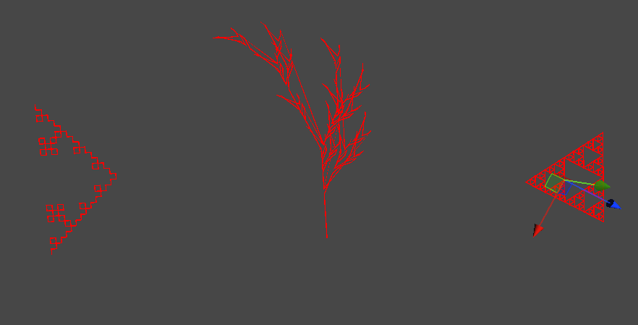
Pseudocode Explanation
1. Initialize the L-system with an axiom and rules.
2. Iterate over the number of generations to apply the rules through string modification.
3. Store the resulting finale string.
4. Use turtle graphics to interpret the generated string via conditional checks
5. Draw the resulting fractal in Unity.

Slide 16
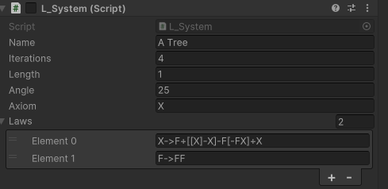
Takeaway Task for Students Make it 3D
1. Have all this set up in Unity
2. Do away with ugly line renderer and bring in some 3D gameObjects and reference to script.
Create a branch prefab, Min: Create a cylinder default shape and texture it woody, perhaps its length can be set to globally to adjust the tree?
Create a leaf prefab, Min: plane with correctly set up transparent shader and tex.
3. Can the turtle do more moves, at the moment he is only drawing on 2D dimensions, what if he could do more?
Manipulate and add conditionals to decide which way the turtle moves next in a more 3D way.
New symbols could mean new directions.
Maybe a better starting string could help.
Experiment and discover new and interesting results.
4. Experiment with different axioms and rules to create various fractals.
Improve the L-system script, make it so the rules are no longer hard coded
For example: https://piratefsh.github.io/p5js-art/public/lsystems/ Lets you paste in angle, axiom, rules, iterations, length. Your script should do the same
5. Bonus: Create a Editor window to Generate L-systems into new scenes.
The next couple of pages outline what your script should be able to generate.

Slide 17
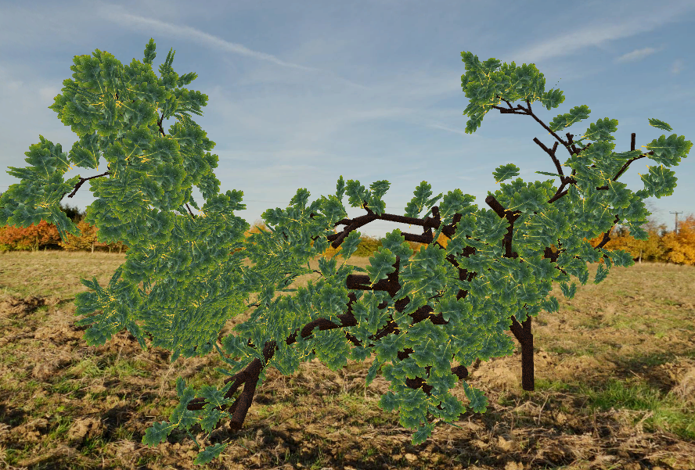
Some quality examples

Slide 18
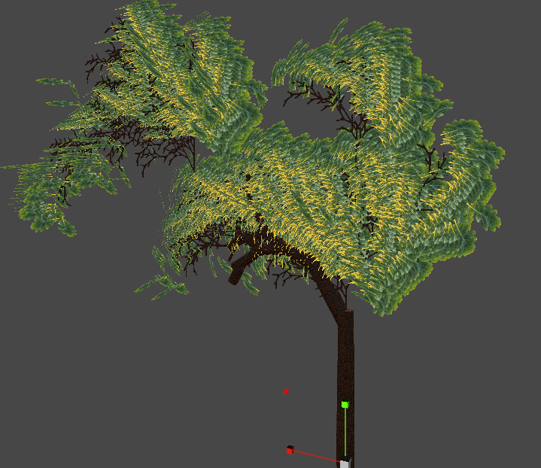
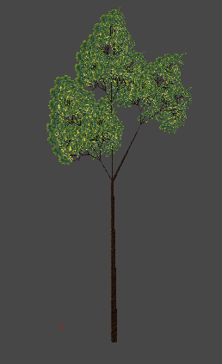
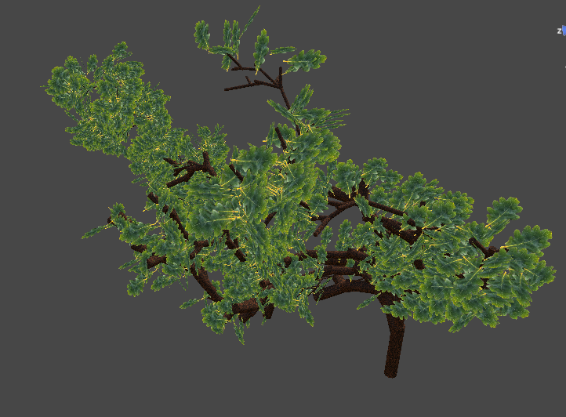
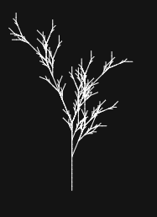

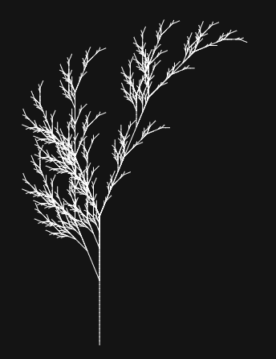
Stochastic Fuzzy Weed
Fuzzy Weed
I manipulated to look
More bonsai
Arrow Weed

Slide 19
